Slide 1


Common Voice:

Slide 2

Agenda:
Einführung
Freie Spracherkennung
Common Voice
Mitmachen
Notes:
This is the agenIntroduction
Why Free Speech
Common Voice
Contribute
da.

Slide 3
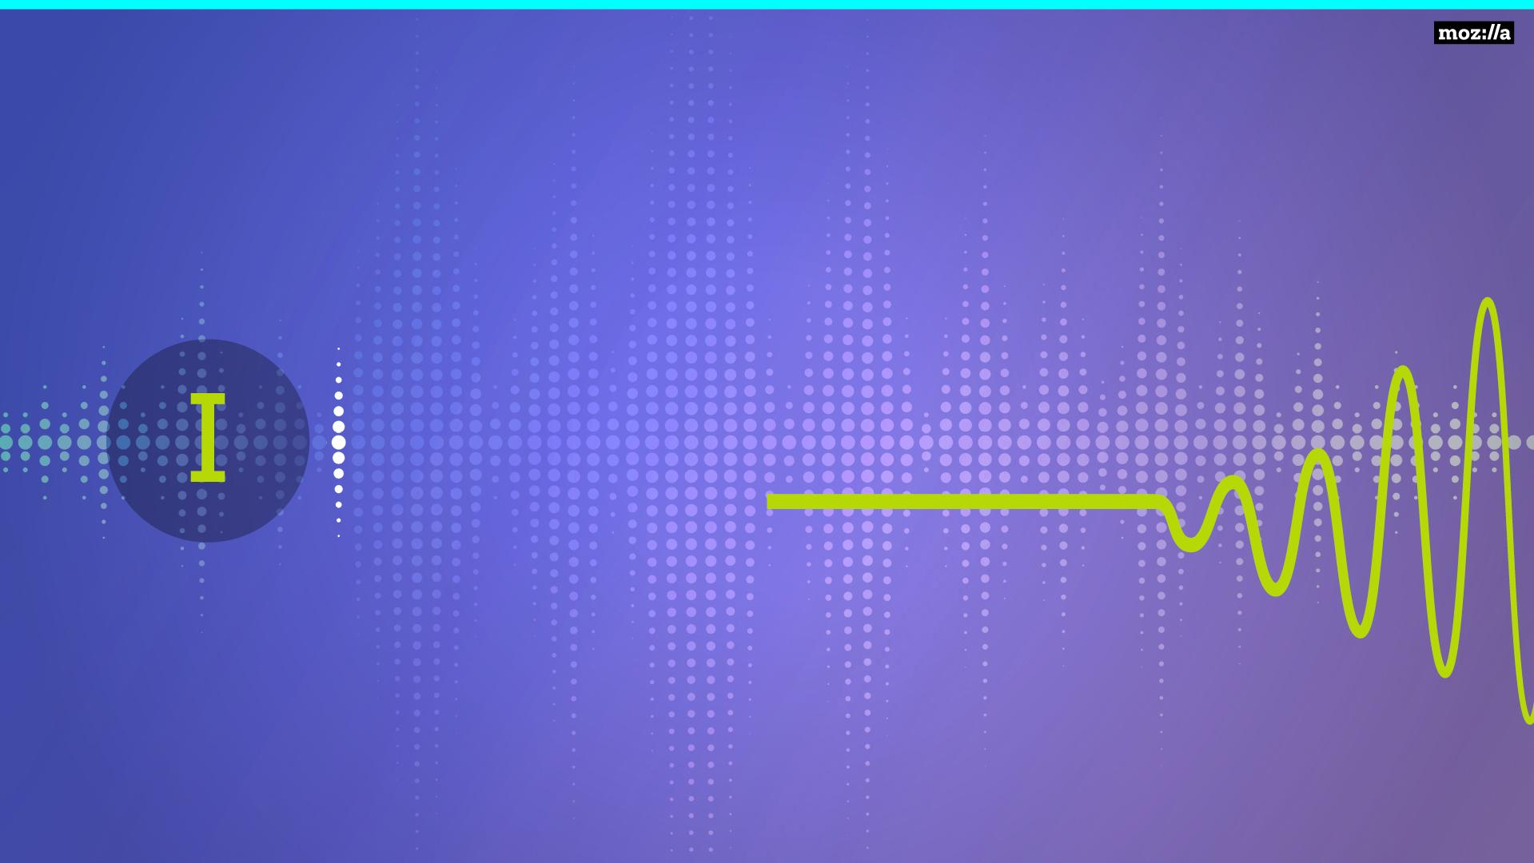
Einführung

Slide 4
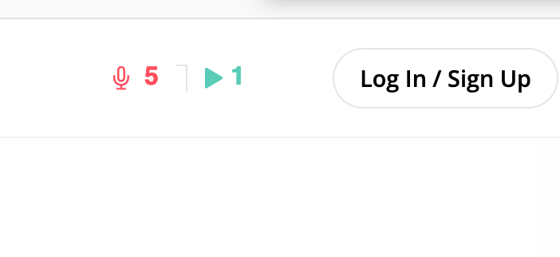
Willkommen!
Einführung
Warum freie Spracherkennung?
Common Voice
225
450

Slide 5
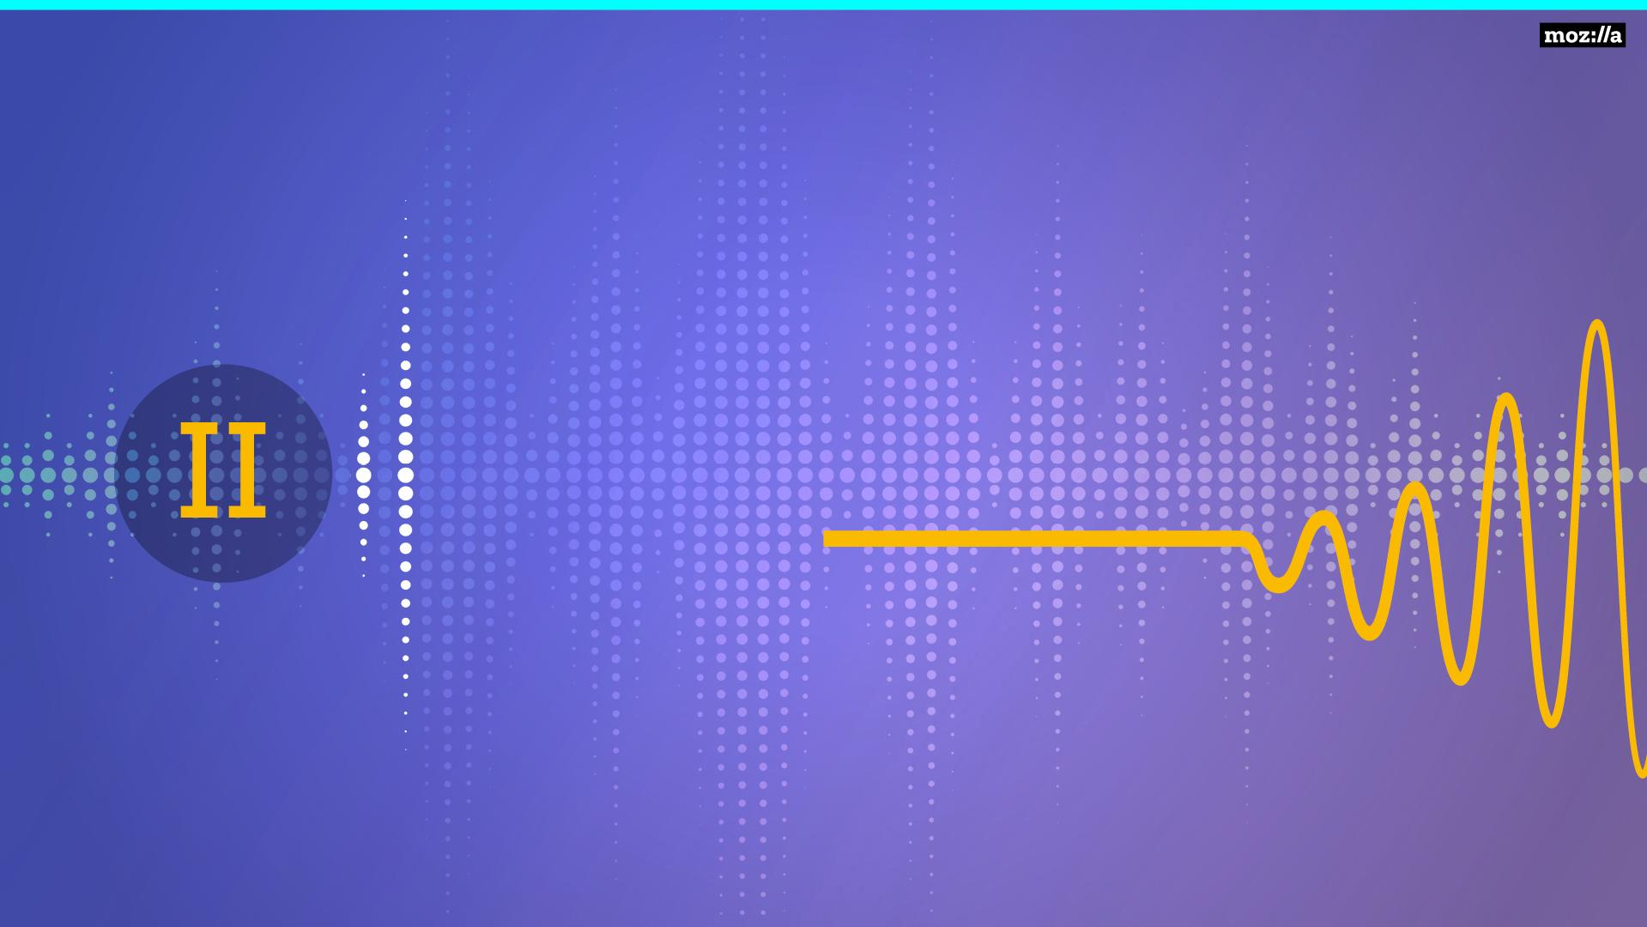
Warum freie Spracherkennung?

Slide 6
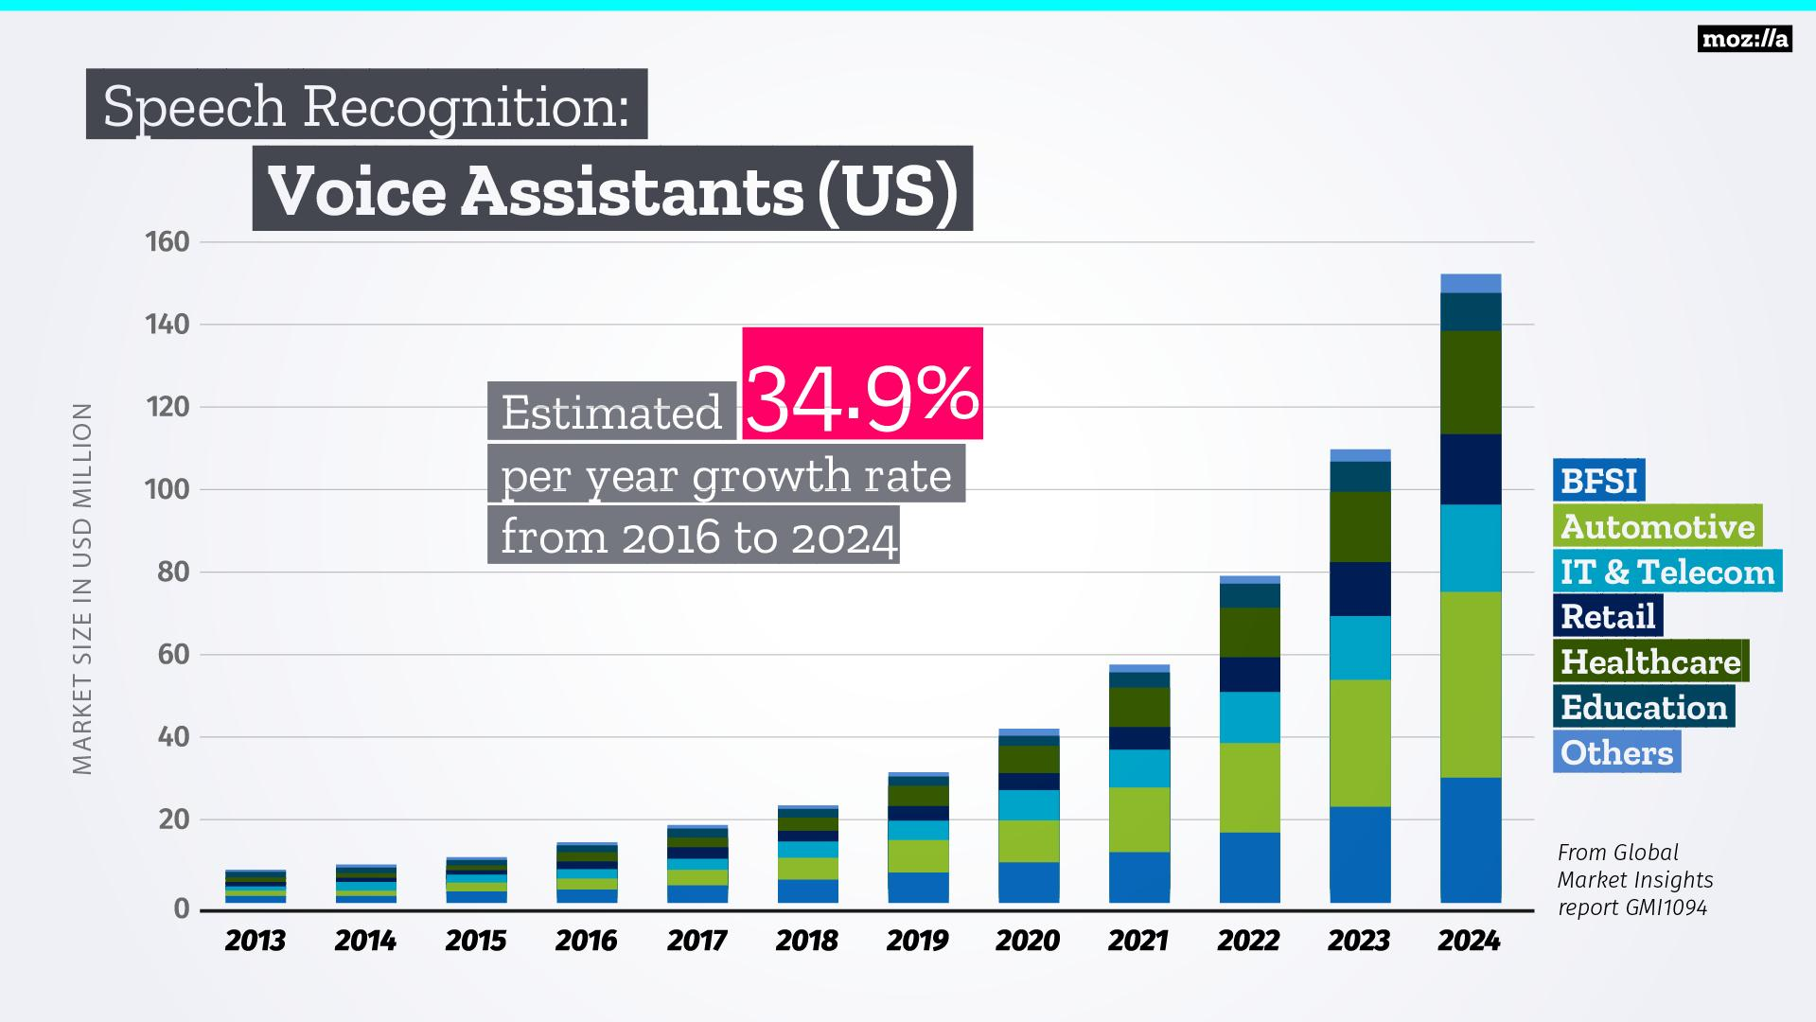
Notes:
More people than ever are using voice assistants!

Slide 7
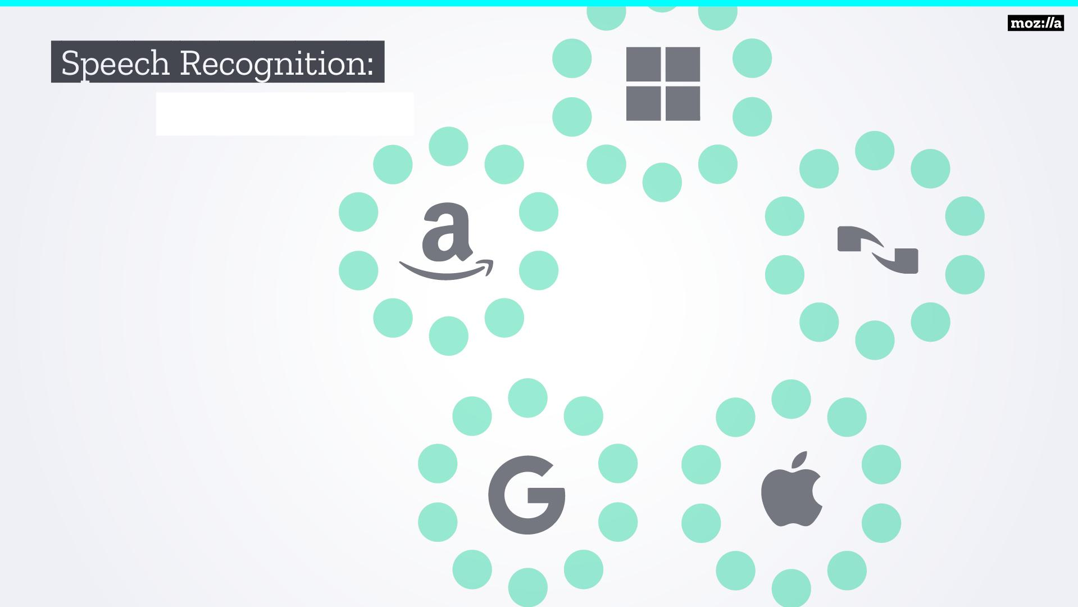
Polypolisten
Notes:
Speech recognition is owned by a few proprietary players. Most of the data isn’t available to individuals - this stifles innovation!

Slide 8
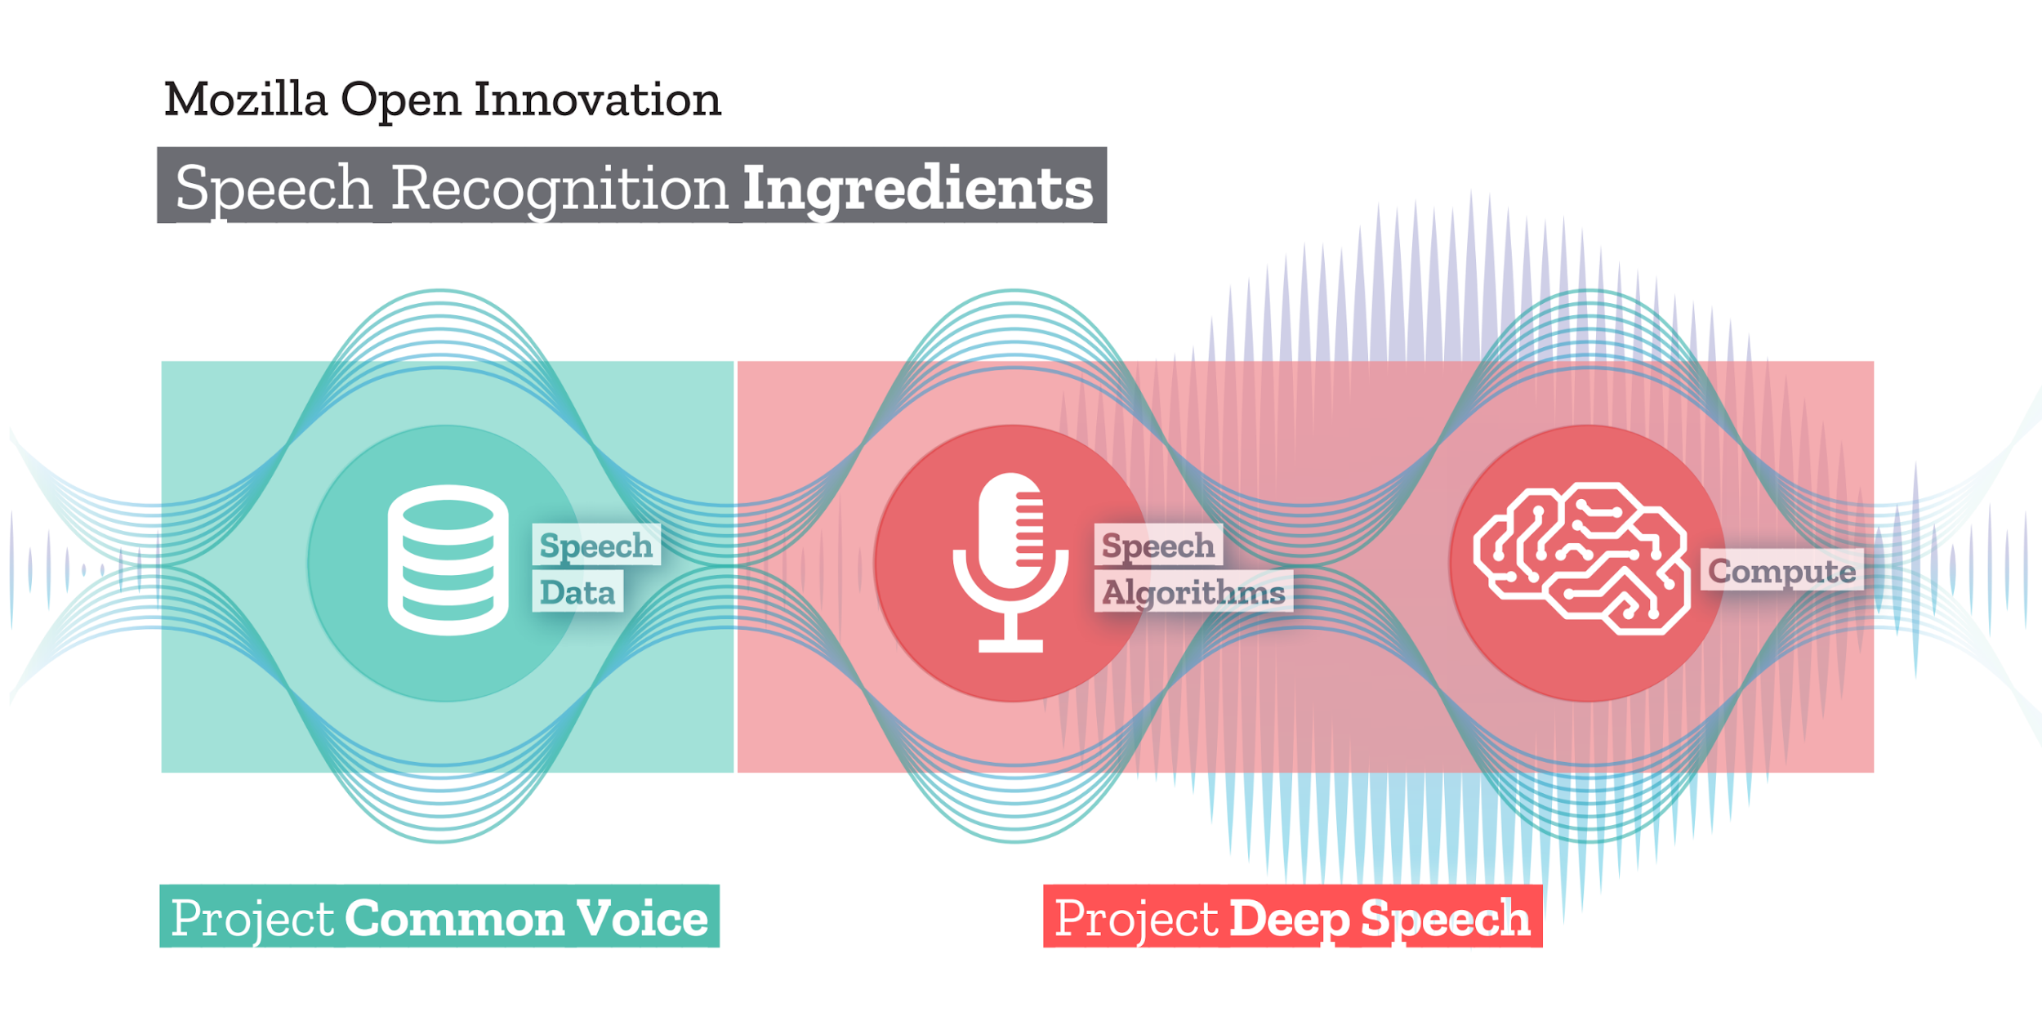
Spracherkennung
Zutaten
Notes:
Common voice is about collecting voice data in a SAFE and ETHICAL way, that can be used to train speech recognition algorithms like our own Deep Speech and models for specific use cases.

Slide 9

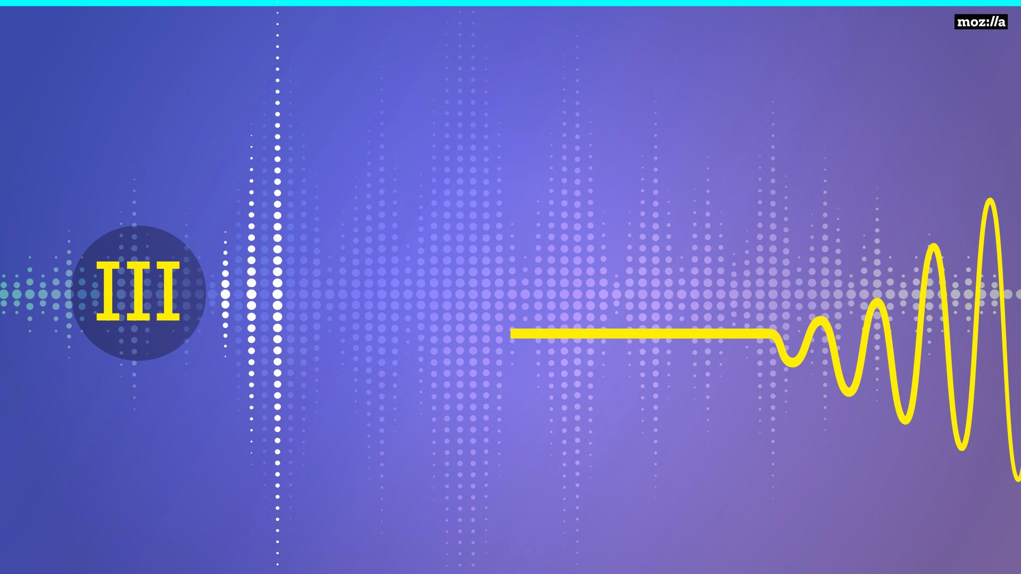
Common Voice
Common Voice

Slide 10
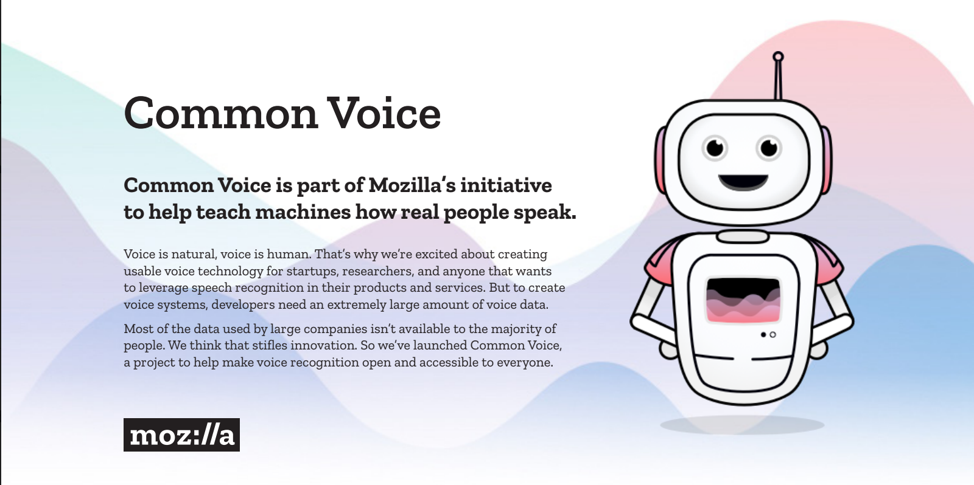

Slide 11
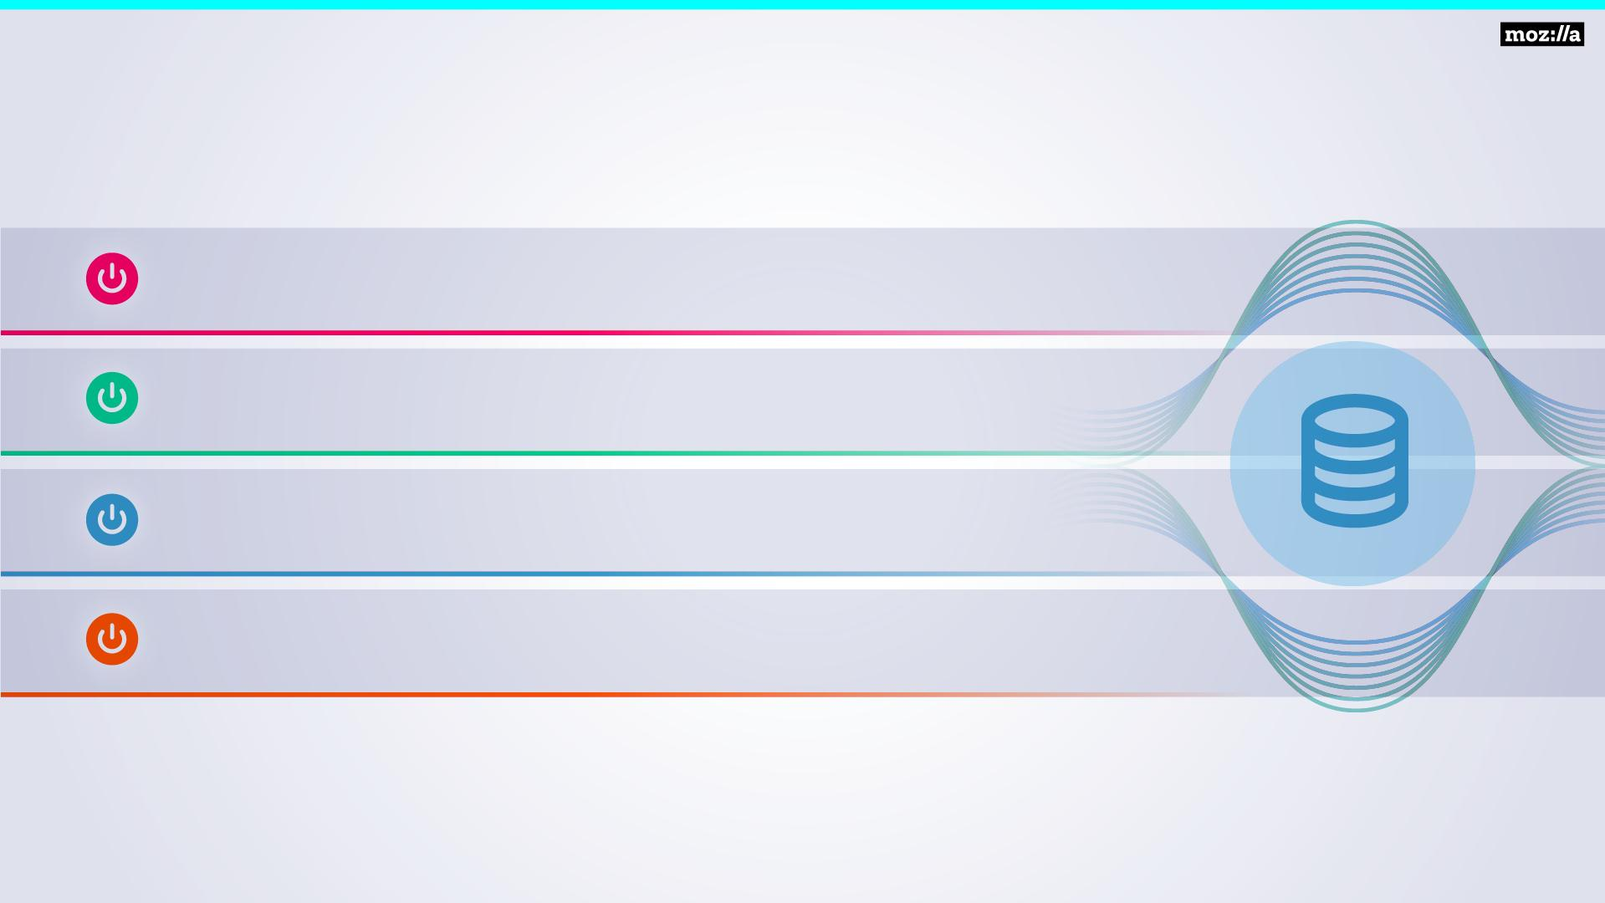
Common Voice
Strategie
Mobilisiere hunderttausende SpenderInnen
Sammle die Spenden anonymisiert
Organisiere Sprecher aus 100+ Sprachen
Öffne die Sprachdatenbank für jeden

Slide 12
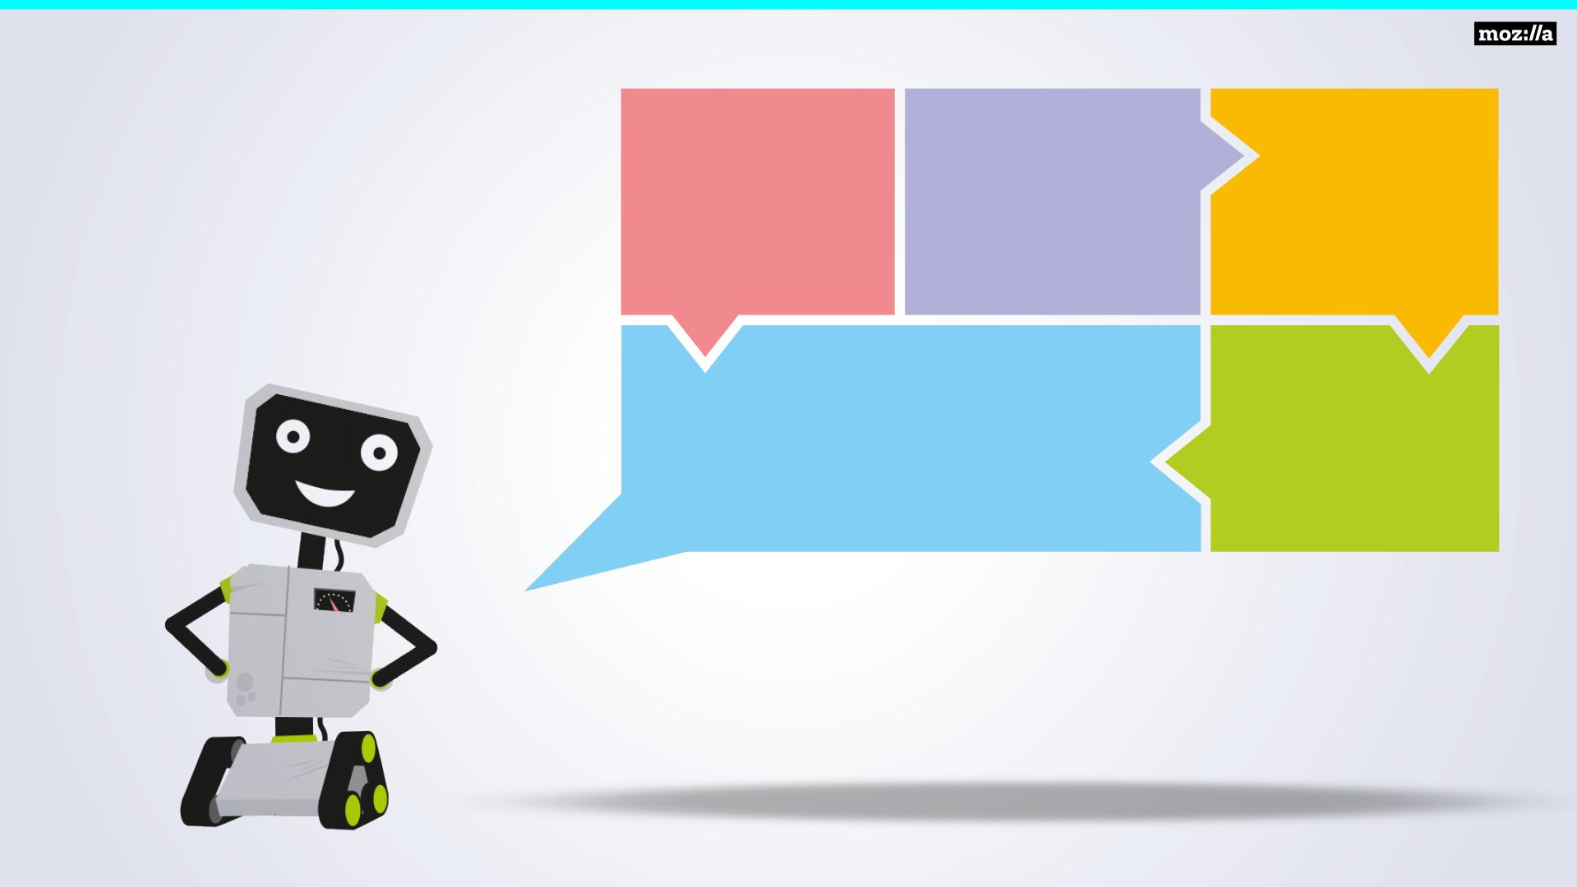

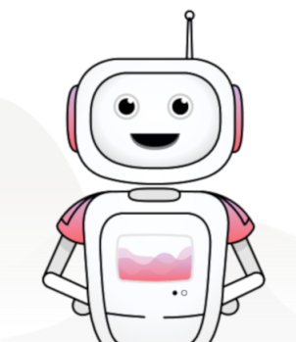
Befreit Sprache!
Offener
Sprach-
Datensatz
Schutz der Privatsphäre
Mozilla’s Mission
Bringt Vielfalt in die Datenbanken
Eine starke globale Gemeinschaft
Notes:
Common Voice connects the dots of Mozilla’s mission and our ability to bring privacy, diversity and community to the speech space.

Slide 13
Unterstützen!

Slide 14
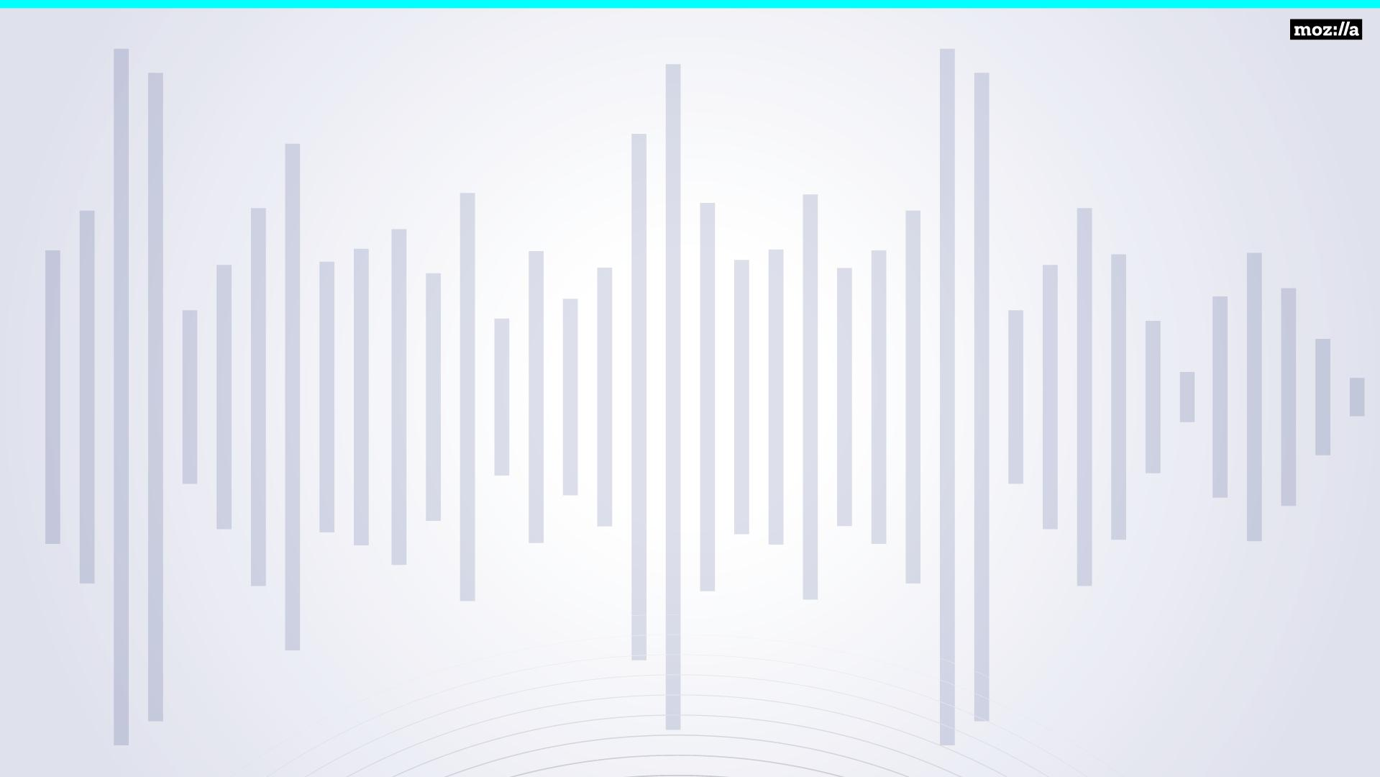
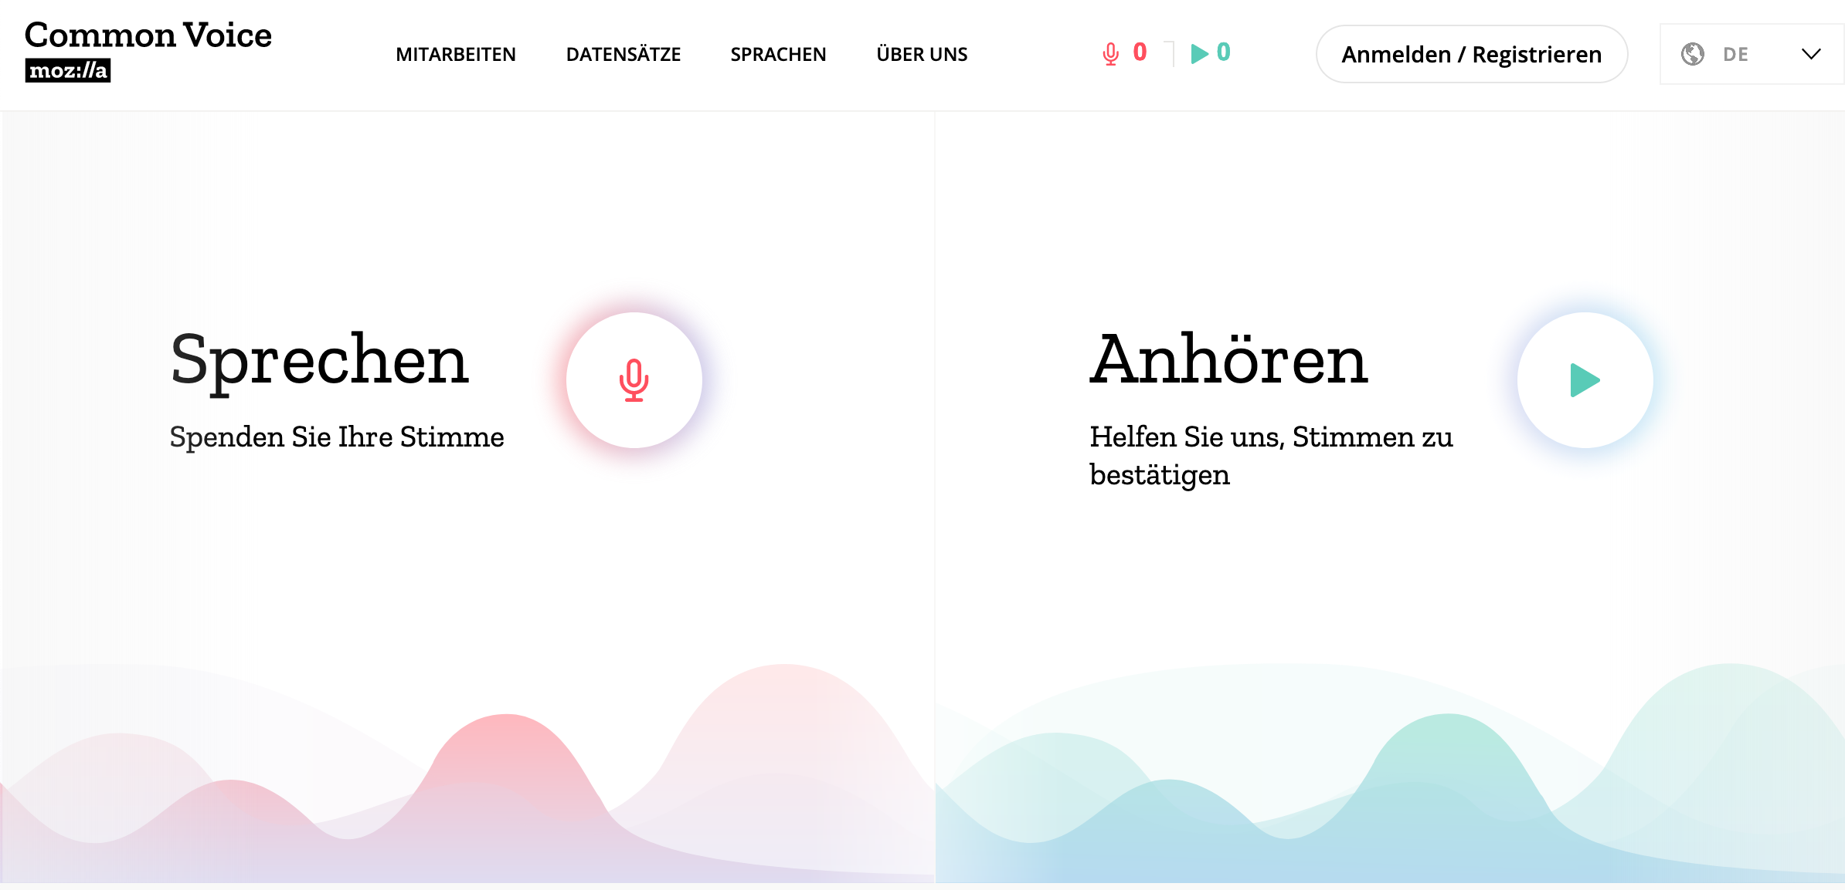
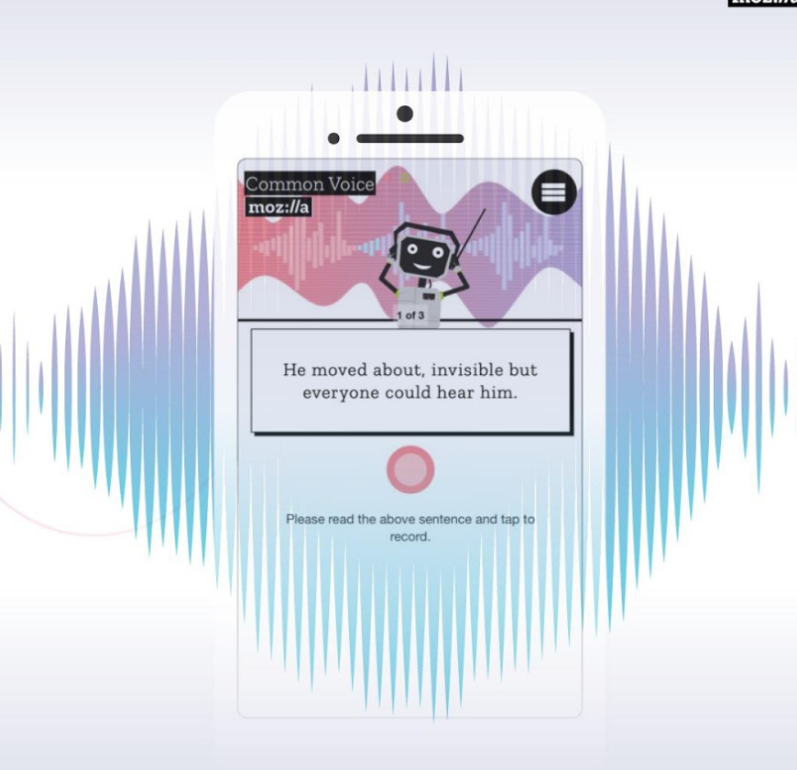
Schritt 1. Geh auf: voice.mozilla.org
PC oder mobil
Notes:
We need people to donate their voice and validate sentences

Slide 15
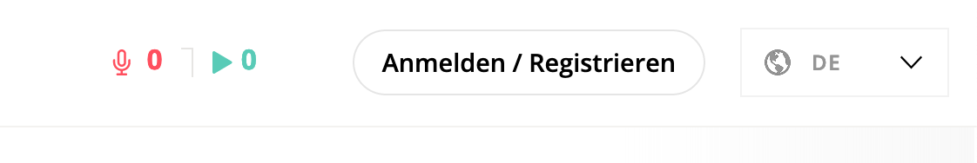
Schritt 2. Erstelle einen Benutzer
voice.mozilla.org
Notes:
We need people to donate their voice and validate sentences. In order to do so they need to login/sign up

Slide 16
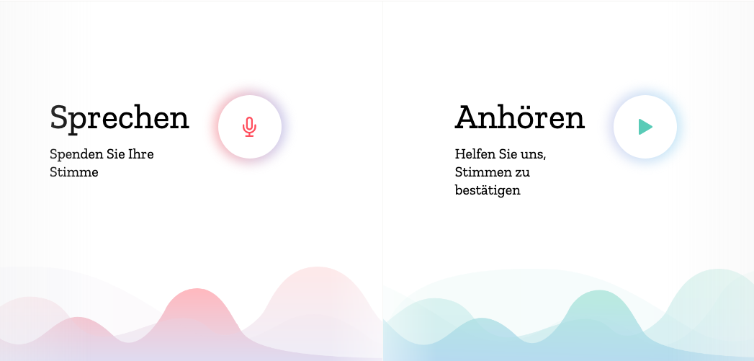
Schritt 3. Spende deine Stimme!
Ziel: 15 Minuten (225 Aufnahmen) pro Person
Notes:
Because we need a diversity of voices it is most helpful if people would donate approx 15 minutes per person

Slide 17
Schritt 4. Überprüfe Stimmen!
Ziel: 450+ Bestätigungen pro Person
Notes:
Because we need a diversity of voices it is most helpful if people also validate voices. The goal is 450 reviews per person

Slide 18
Schritt 5. Beobachte deinen Fortschritt
voice.mozilla.org
Notes:
We need people to both donate their voice and validate sentences. They can see their work on their account

Slide 19
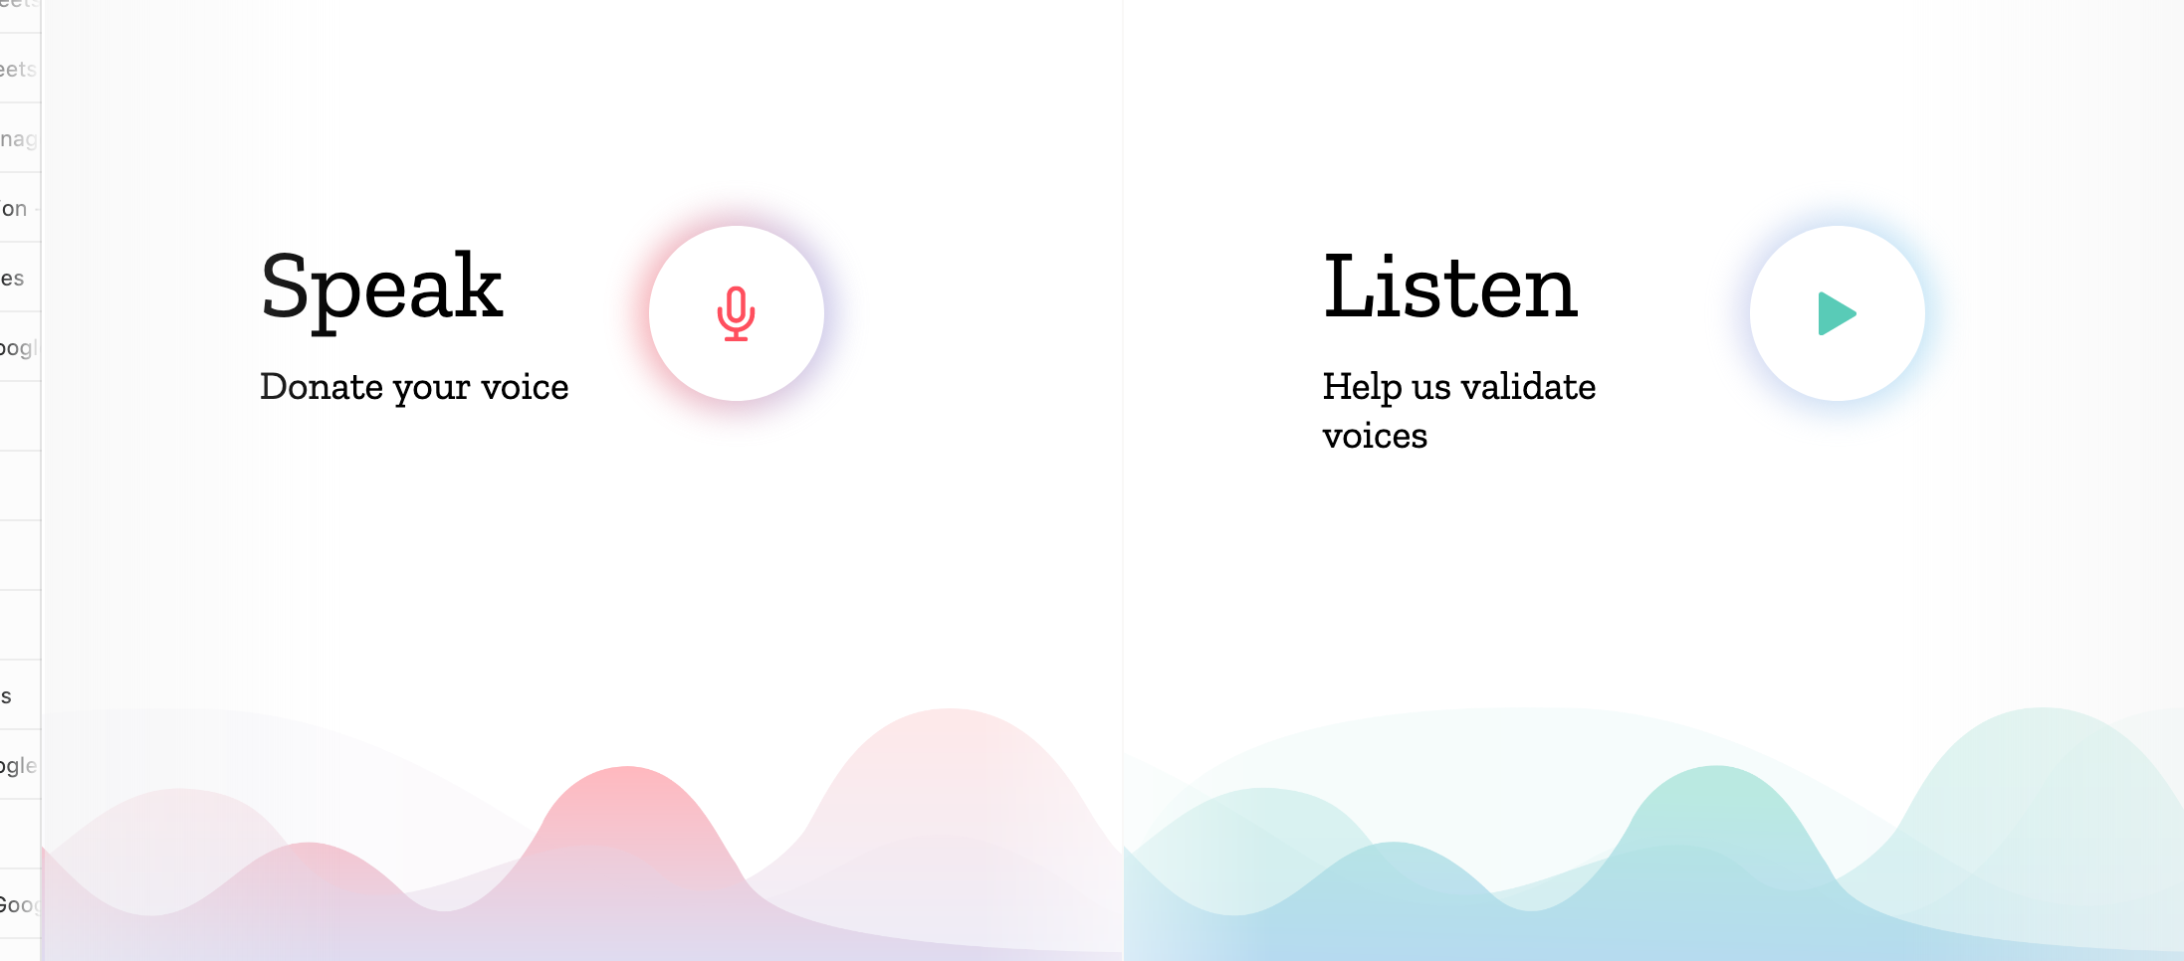

225
450
Feiere deine Arbeit!
voice.mozilla.org
Notes:
We need people to donate their voice and validate sentences

Slide 20
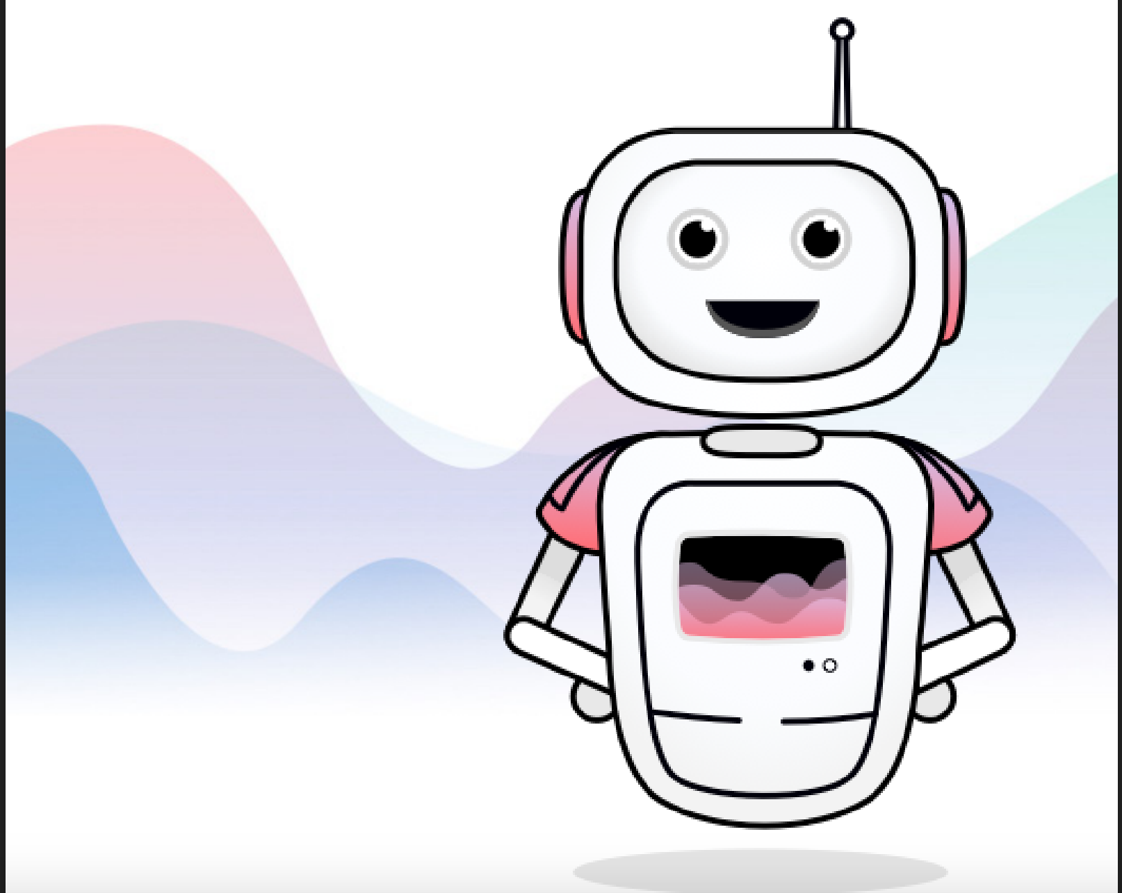


Vielen Dank!
#CommonVoice
Mehr Möglichkeiten bei Mozilla mitzumachen: activate.mozilla.community
450
voice.mozilla.org/de
Notes:
Thank your attendees and ask them to contribute more!

